Slide 1
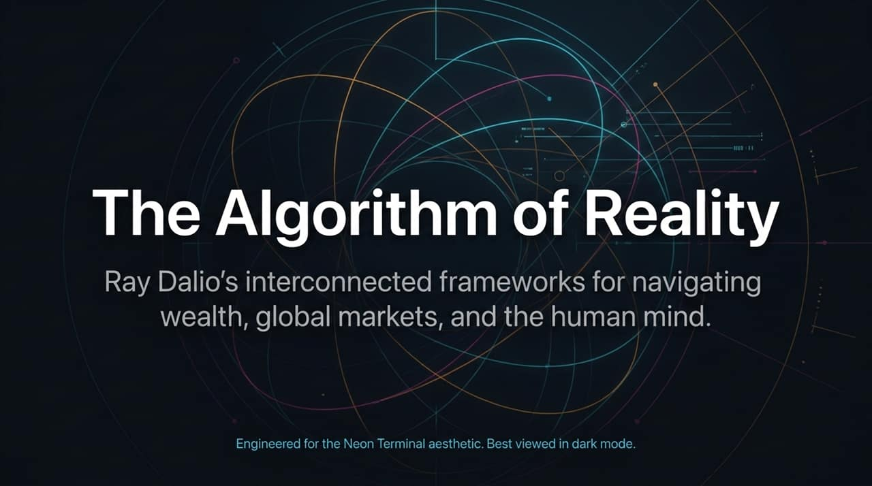
Notes:
https://www.youtube.com/watch?v=UprafhdeZVc
Welcome everyone. Today, we’re delving into The Algorithm of Reality—a systematic breakdown of Ray Dalio’s core frameworks across investing, macroeconomic cycles, decision-making, and human nature.
Dalio’s journey started from humble beginnings and transformed Bridgewater into the world’s most successful hedge fund. But his core realization wasn't just about financial models; it was about treating reality as a set of predictable cause-and-effect machine loops.
Throughout this presentation, we will bridge these high-level macro concepts with actionable personal and organizational principles.

Slide 2
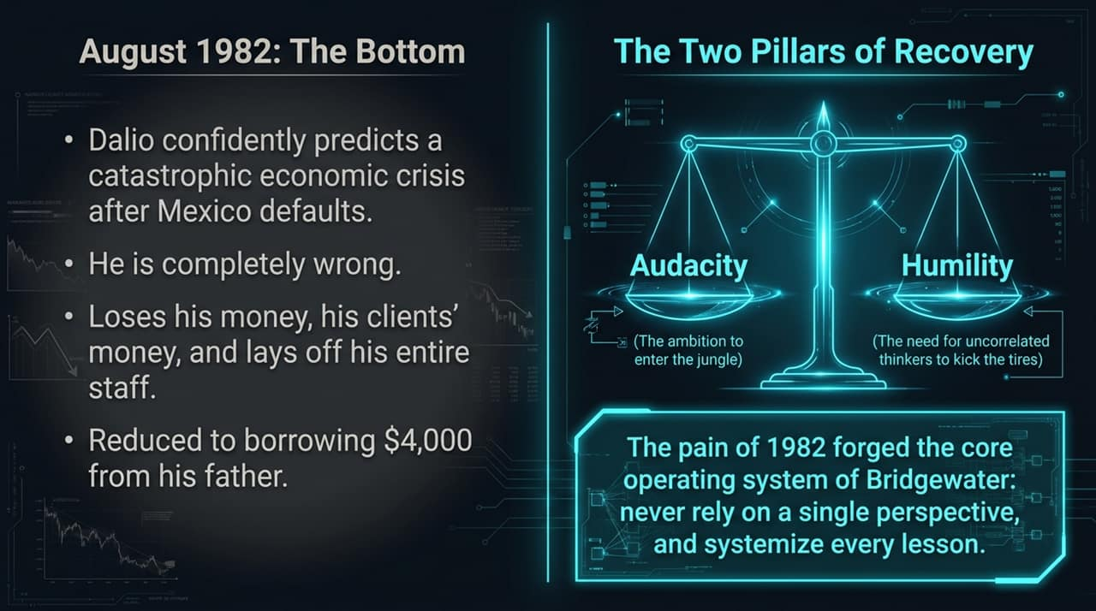
Notes:
In August 1982, Mexico defaulted on its debt. Dalio confidently predicted a massive global financial disaster and even testified before Congress about it.
The Failure: He was completely wrong. The markets rallied, and Dalio lost so much money for himself and his clients that he had to lay off his entire staff. He was so broke he had to borrow $4,000 from his father just to pay family living expenses.
The Pivot: This devastating low forced a transformation, forging Bridgewater’s core operating system:
Audacity: The ambition to enter the "jungle" and pursue aggressive upside.
Humility: The critical realization that he needed to seek out independent thinkers to "kick the shit out of" his ideas to expose blind spots.

Slide 3
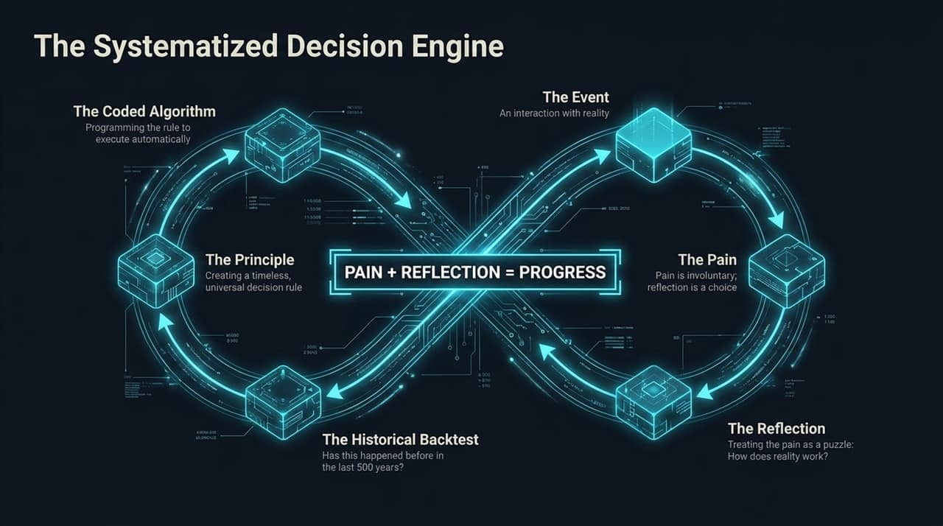
Notes:
Dalio’s central formula for personal and organizational evolution is: Pain + Reflection = Progress.
Pain is an involuntary encounter with reality. However, reflection is a conscious choice. When you treat pain as a puzzle to solve rather than an obstacle to avoid, you discover how reality actually works.
The Engine Loop:
The Event & Pain: An interaction occurs that leads to failure or loss.
Reflection: Asking, "What does this tell me about cause-and-effect?"
Historical Backtest: Checking if this pattern has occurred in history over the past 100 to 500 years.
The Principle: Codifying a timeless, universal decision rule (e.g., "If X happens, do Y").
Coded Algorithm: Programming the rule into automated systems to eliminate human emotional bias.

Slide 4
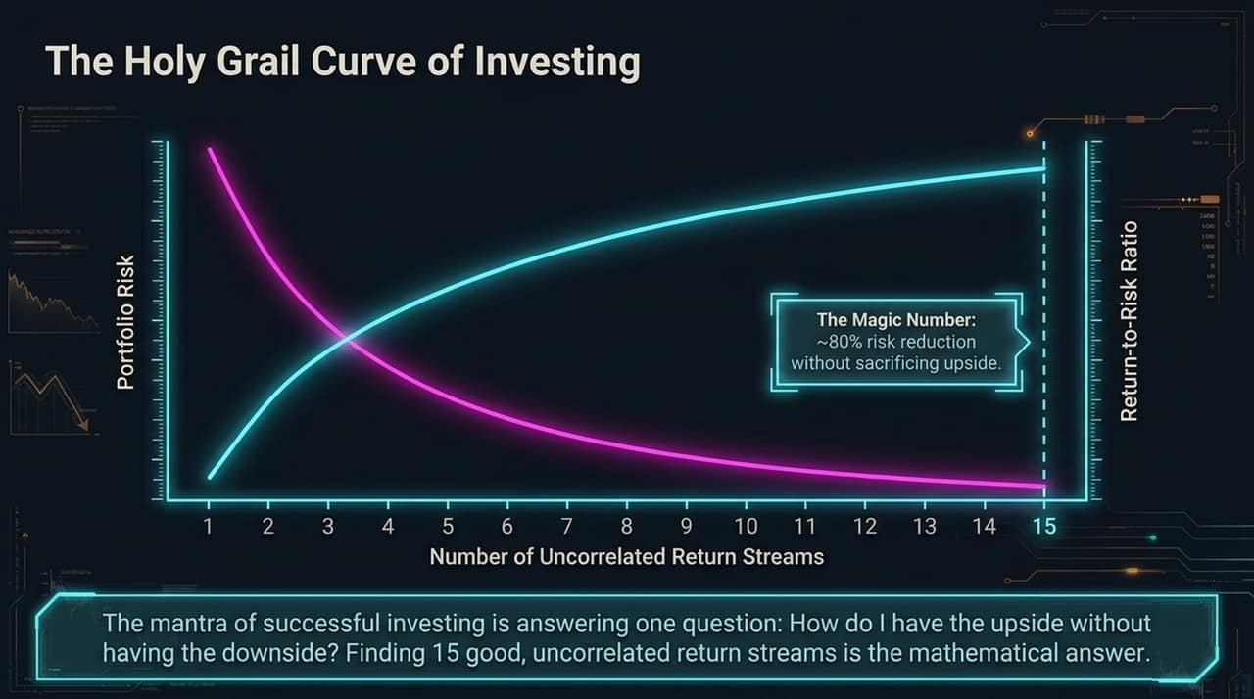
Notes:
Dalio describes the fundamental question of investing as: "How do I get the upside without taking the downside?"
The Math Behind the Curve: By combining 15 or more uncorrelated return streams, you can reduce overall portfolio risk by approximately 80% without sacrificing overall expected return.
This shifts the return-to-risk ratio upward by roughly a factor of five.
Key Takeaway: True diversification isn't just owning many assets; it requires finding independent streams of return whose underlying market mechanics do not move together.

Slide 5
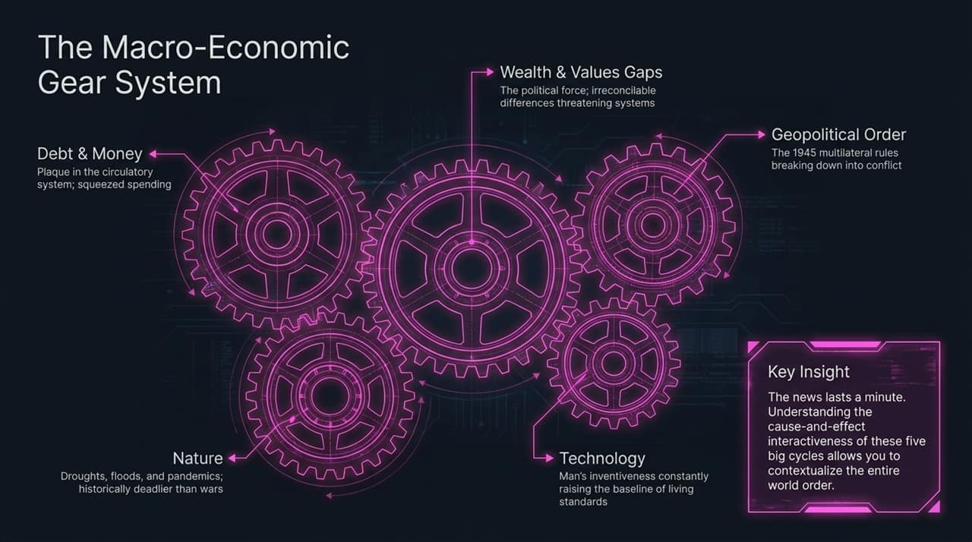
Notes:
Daily news lasts a minute; understanding cause-and-effect macro cycles gives context to the entire world order. Dalio identifies 5 interconnected forces:
Debt & Money: Debt accumulation acts like plaque in an artery. Eventually, debt-service obligations squeeze out spending, triggering devaluations or restructurings.
Wealth & Values Gaps: Expanding financial inequality leads to political polarization, irreconcilable differences, and systemic gridlock.
Geopolitical Order: Shifts in the post-1945 multilateral rules-based system, moving toward unilateral conflict and competition.
Nature: Pandemics, droughts, and floods—historically responsible for more casualties and economic disruption than wars.
Technology: Human inventiveness constantly lifting baseline productivity and living standards.

Slide 6
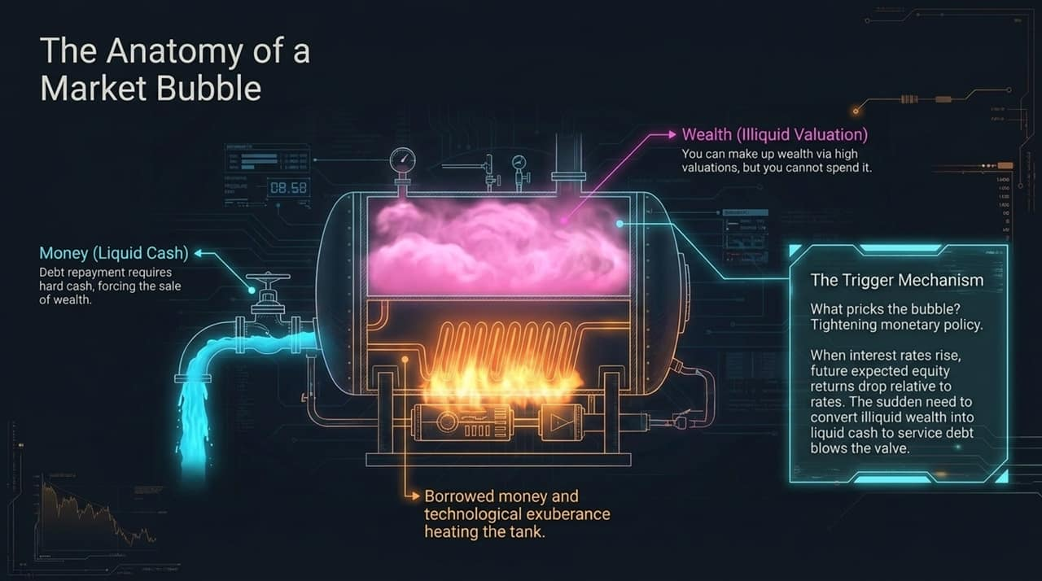
Notes:
To understand market bubbles, we must distinguish between Illiquid Wealth and Liquid Money.
Wealth vs. Cash: Valuation metrics can make an asset look worth billions on paper, but you cannot directly spend valuation; you can only spend liquid cash.
The Bubble Dynamic: Borrowed money and technological excitement fuel asset prices. Investors buy in at elevated prices assuming growth will continue indefinitely.
The Trigger Mechanism: When central banks tighten monetary policy or interest rates rise, borrowing becomes expensive. Investors are suddenly forced to liquidate illiquid wealth to generate liquid cash to pay off debt obligations, pricking the bubble.

Slide 7
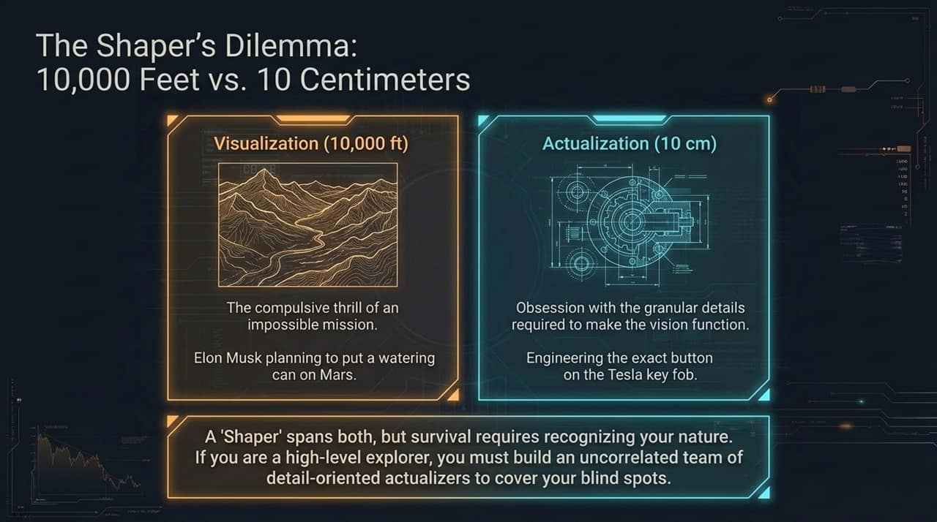
Notes:
Through extensive psychometric testing on high-achievers like Elon Musk, Bill Gates, and Reed Hastings, Dalio identified a rare personality archetype: The Shaper.
10,000 Feet (Visualization): Driven by the compulsive thrill of an impossible mission—such as Elon Musk conceiving a plan to put a plant in a watering can on Mars.
10 Centimeters (Actualization): Simultaneously obsessing over the micro-level engineering required to execute the vision—down to designing the exact button on a key fob.

Slide 8
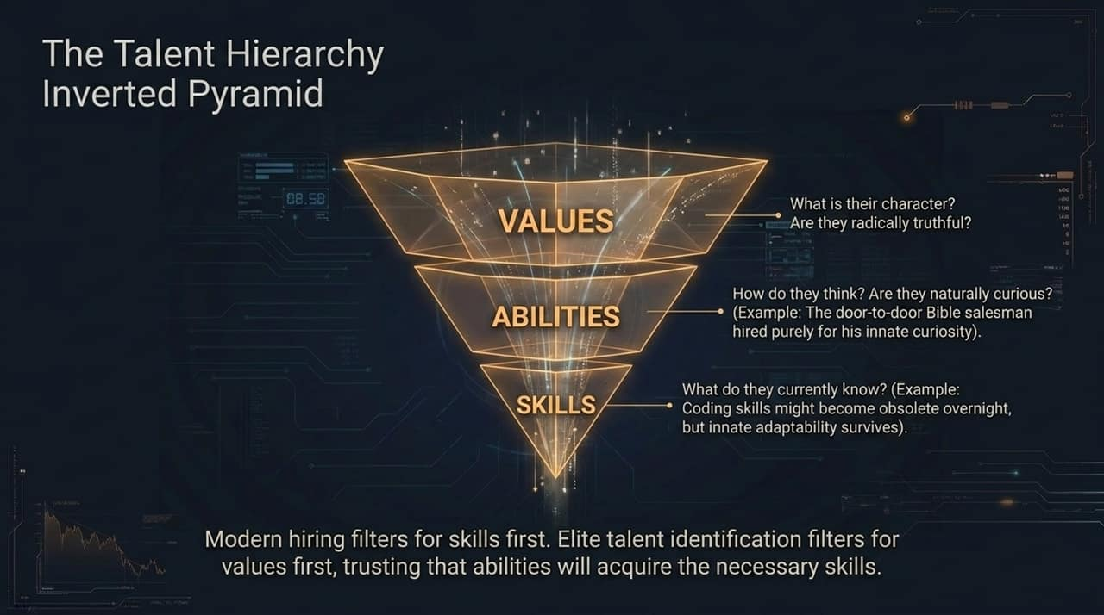
Notes:
Standard corporate hiring filters for Skills first (e.g., programming languages, resume accomplishments).
Dalio’s Priority Pyramid:
Values (Base Level): Core character, radical truthfulness, and alignment with the team's mission.
Abilities: How a person thinks, their innate curiosity, and mental agility. (e.g., hiring a door-to-door Bible salesman purely because of his intense curiosity).
Skills (Top Level): Specific knowledge. Skills quickly become obsolete as technologies shift, but strong values and adaptive abilities endure.

Slide 9

Notes:
Humans operate across three mental layers: the Logical Conscious, the Subliminal/Emotional, and the Deep Subconscious.
Meditation as a Tool: Dalio credits Transcendental Meditation (TM)—practiced daily since 1969—for his clarity and calmness.
Repetitive, non-meaningful mantras (like "m") quiet conscious chatter and emotional instincts. This allows a person to descend like a weighted plumb line into the deep subconscious, where high-level creativity and core principles reside.

Slide 10
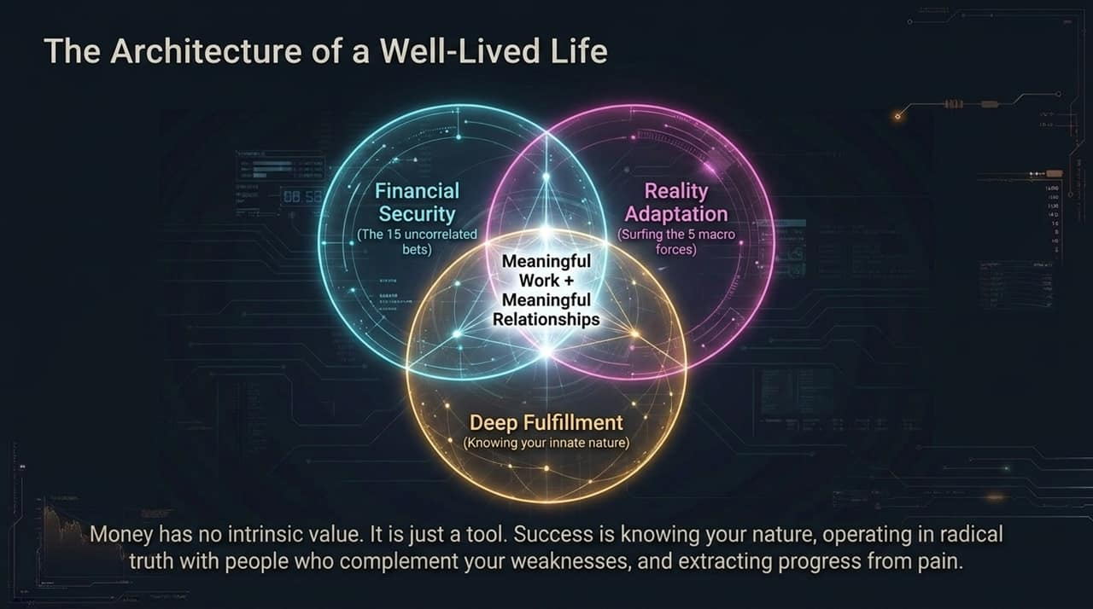
Notes:
Money has no intrinsic value; it is merely a tool. Accumulating money without a clear purpose is meaningless.
The Four Pillars of Life Fulfillment:
Financial Security: Built on 15 uncorrelated risk streams.
Reality Adaptation: Navigating the 5 macro forces.
Deep Fulfillment: Understanding your innate nature and aligning your life with it.
Meaningful Work + Meaningful Relationships: Operating in radical truth with individuals who complement your weaknesses.

Slide 11
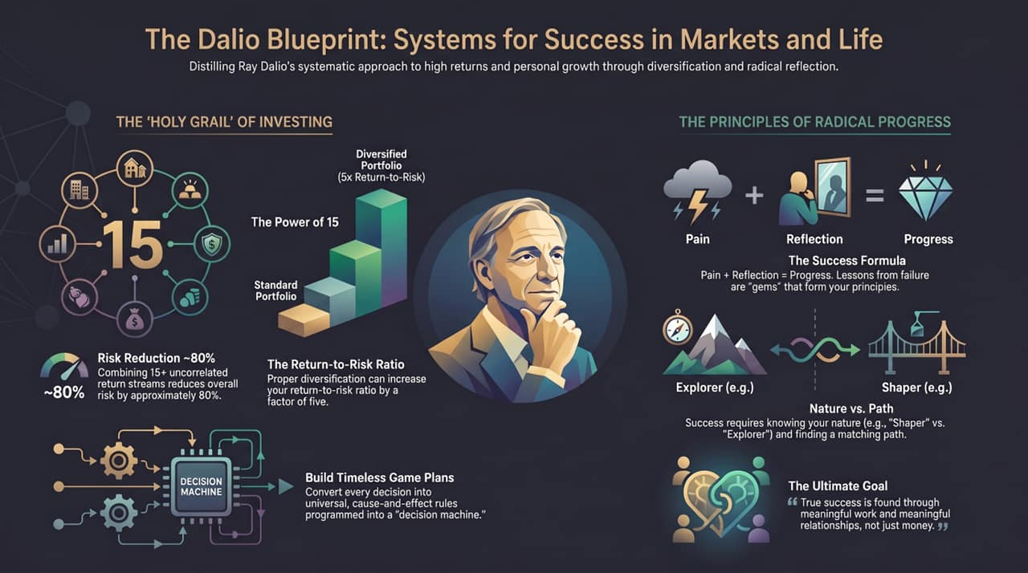
Notes:
Highlighting the personal progress formula: Pain + Reflection = Progress.
Failures are "gems" that provide the underlying principles for future decision-making.
Knowing your nature—whether you are an Explorer or a Shaper—is the primary requirement for choosing a career path that brings fulfillment.

Slide 12

Notes:
Reiterating the Holy Grail of Investing: 15+ independent, uncorrelated return streams achieve an ~80% risk reduction and a 5x improvement in the return-to-risk ratio.
Decision-making must be codified into "decision machines" based on universal cause-and-effect rules tested across history.

Slide 13
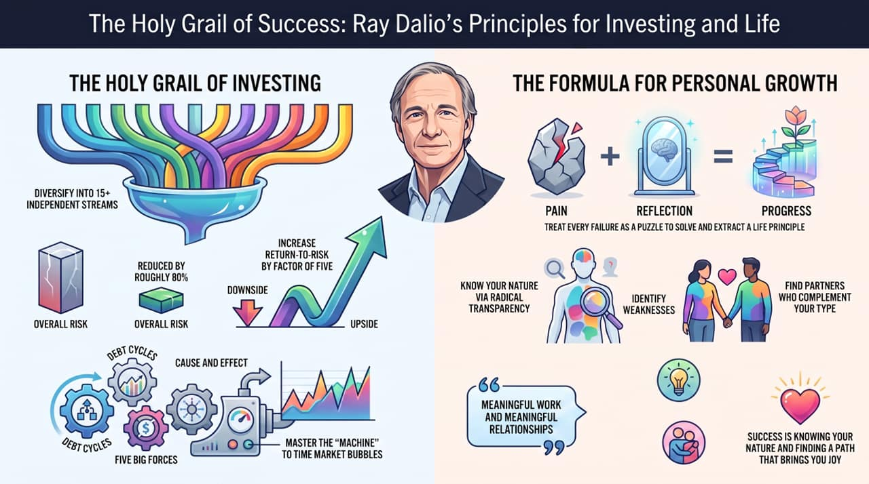
Notes:
Final Synthesis:
Combine systemic market diversification with radical self-awareness.
Master macro debt cycles and market bubble dynamics to navigate systemic shifts.
Identify your weaknesses, embrace radical transparency, and find complementary partners.
True success is defined by finding joy in meaningful work and cultivating deep, meaningful relationships.

